Slide 1
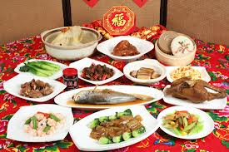
chī nián yè fàn xué jí xiáng huà 吃年夜飯 學吉祥話
Learning lucky words at New Year’s dinner

Slide 2
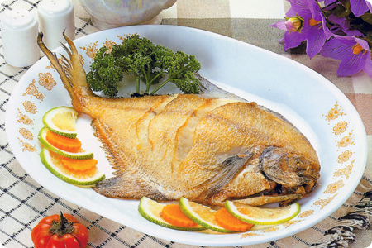
nián nián yǒu yú 年年有餘
yú 魚
Have surpluses every year!

Slide 3
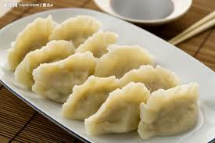
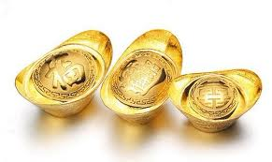
zhāo cái jìn bǎo 招財進寶
jiǎo zi yuán bǎo 餃子=元寶
Good fortune!

Slide 4
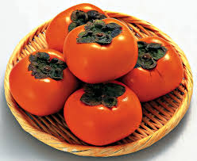
shì shì rú yì 事事如意
shì zi 柿子
Hope everything is going well!

Slide 5
píng píng ān ān 平平安安
píng guǒ 蘋果
Have peace!

Slide 6
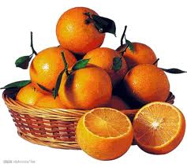
dà jí dà lì 大吉大利
jú zi 橘子
Have a prosperous New Year!

Slide 7
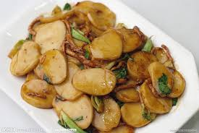
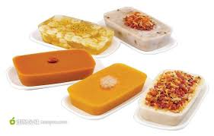
nián nián gāo shēng 年年高升
nián gāo 年糕
Promoted every year!

Slide 8
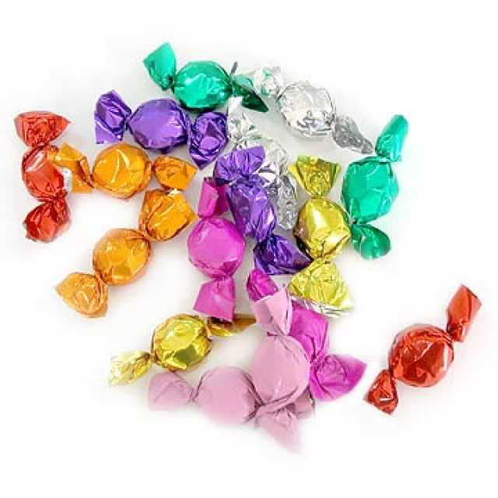
tián tián mì mì 甜甜蜜蜜
táng guǒ 糖果
Have a sweet and happy New Year!

